Slide 1
St. Louis Central Corridor West Building Permits
Monthly Report: March 2021

Slide 2
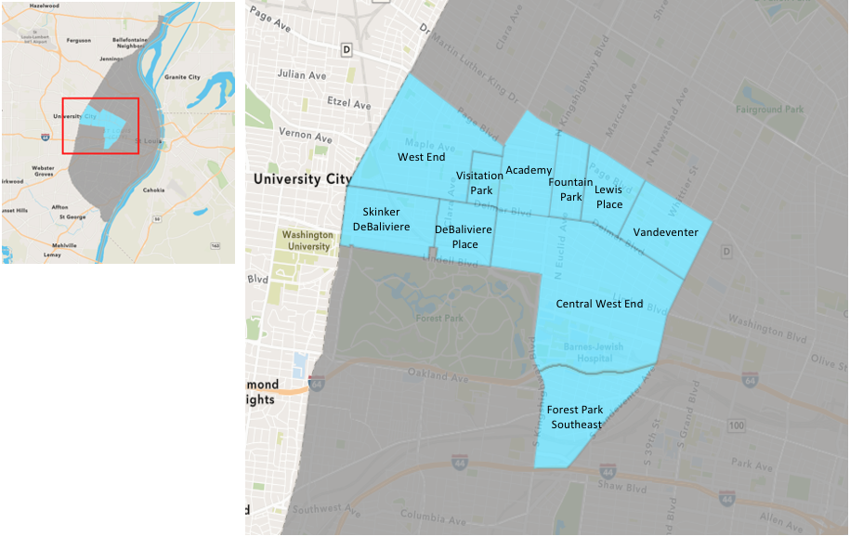
St. Louis Neighborhood Spatial Reference

Slide 3
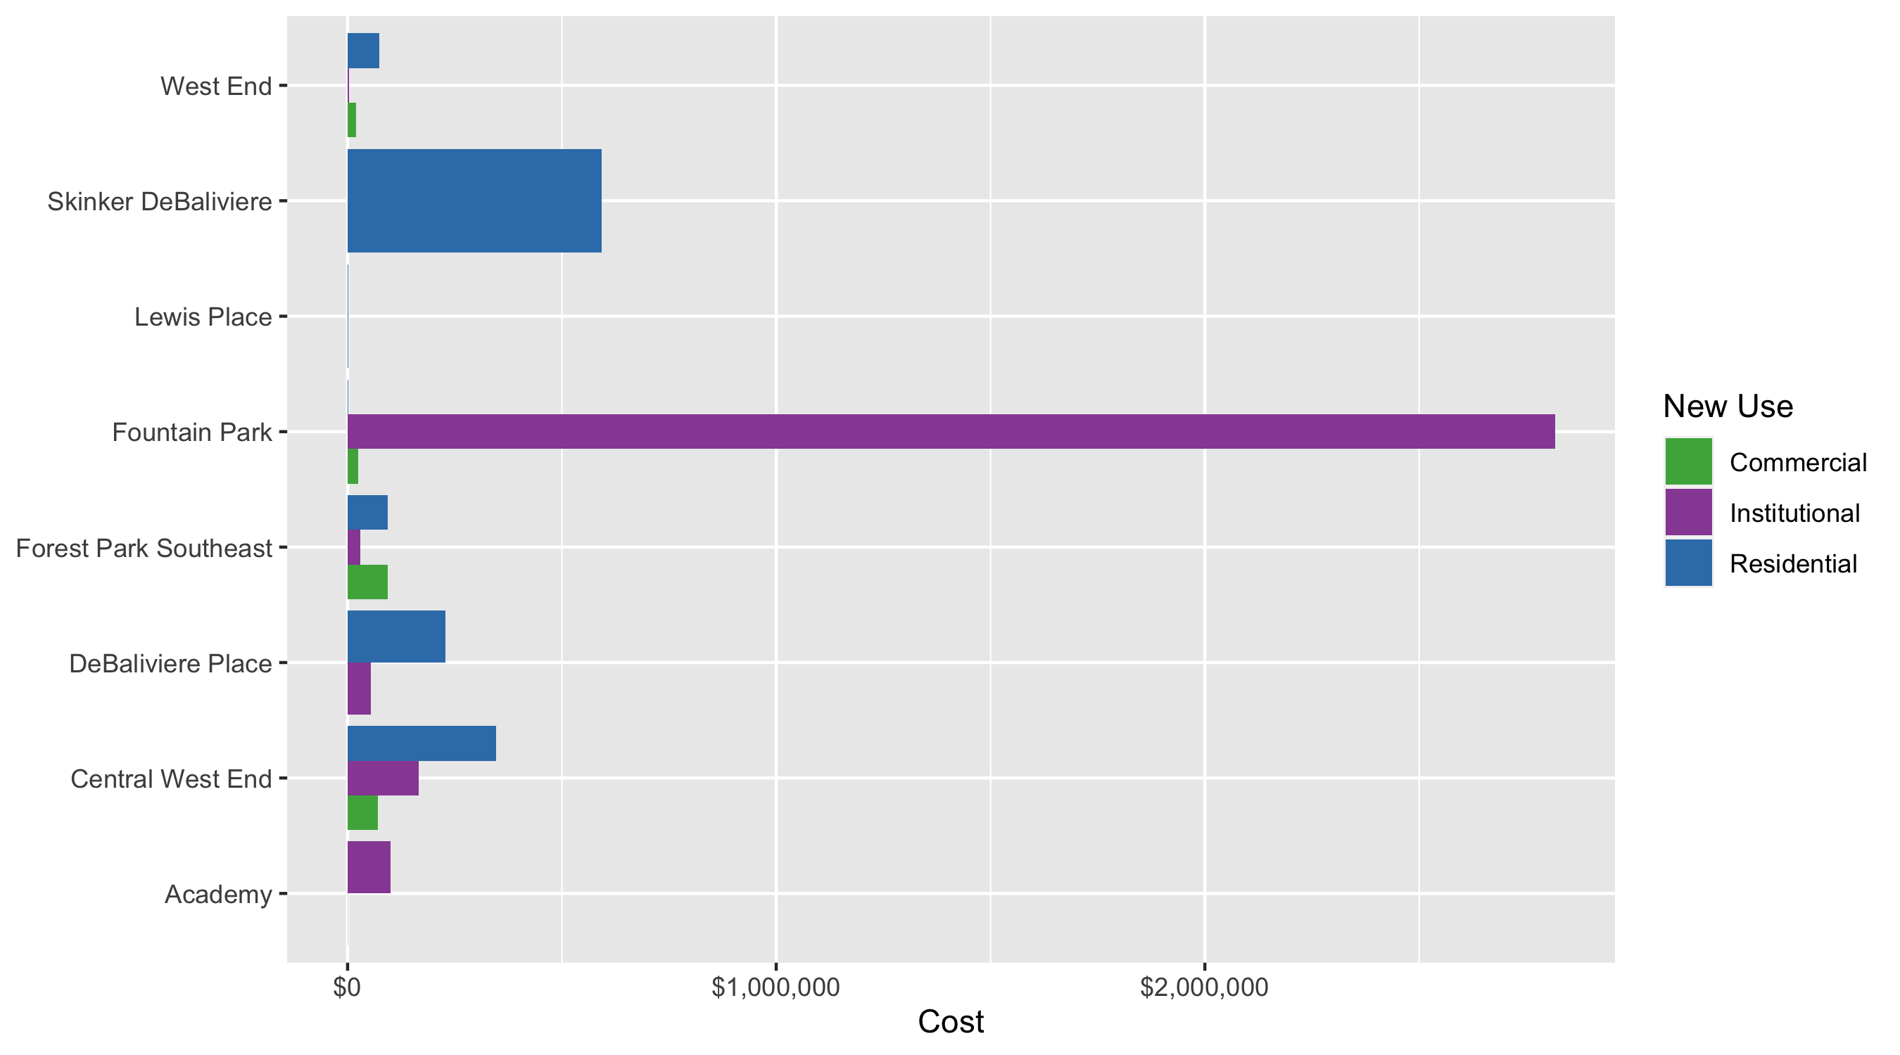
Neighborhood Summary: Average Building Permit Cost

Slide 4
Neighborhood Summary
March 2021 | March 2021 | March 2021 | March 2021
Neighborhood | Average Cost | # of Permits | Total Value of Permits
Academy | $50,250 | 2 | $100,500
Central West End | $253,529 | 48 | $12,169,401
DeBaliviere Place | $170,000 | 3 | $510,000
Forest Park Southeast | $87,792 | 20 | $1,755,835
Fountain Park | $407,321 | 7 | $2,851,247
Lewis Place | $1,000 | 1 | $1,000
Skinker DeBaliviere | $593,519 | 9 | $5,341,670
Vandeventer | $0 | 0 | $0
Visitation Park | $0 | 0 | $0
West End | $53,167 | 6 | $319,000
Last 6 Months | Last 6 Months | Last 6 Months | Last 6 Months
Neighborhood | Average Cost | # of Permits | Total Value of Permits
Academy | $24,471 | 18 | $440,474
Central West End | $845,137 | 199 | $168,182,216
DeBaliviere Place | $88,740 | 25 | $2,218,506
Forest Park Southeast | $798,604 | 75 | $59,895,264
Fountain Park | $584,418 | 11 | $6,428,595
Lewis Place | $9,733 | 11 | $107,063
Skinker DeBaliviere | $144,463 | 55 | $7,945,456
Vandeventer | $25,554 | 6 | $153,323
Visitation Park | $670,091 | 3 | $2,010,274
West End | $77,107 | 52 | $4,009,572

Slide 5
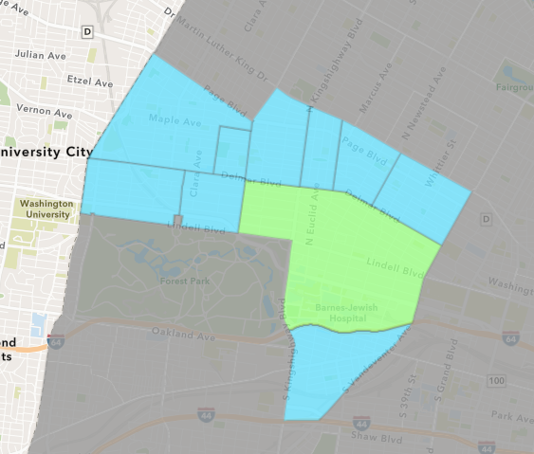
Central West End
March 2021 Neighborhood Cost Breakdown
Mean: $253,529
Median: $23,500
Range: $2,220 - $8,000,000

Slide 6
Central West End: Summary Notes
48 building permits in March 2021
4.35% change compared to March 2020 (46 total building permits)
$253,529: Average building permit cost in March 2021
188.32% change compared to March 2020 ($87,934)
99 total building permits in 2021
-11.61% change YTD compared to this time in 2020 (112 total building permits)
$1,284,626: YTD average building permit cost in 2021
522.93% change YTD compared to this time in 2020 ($206,224)

Slide 7
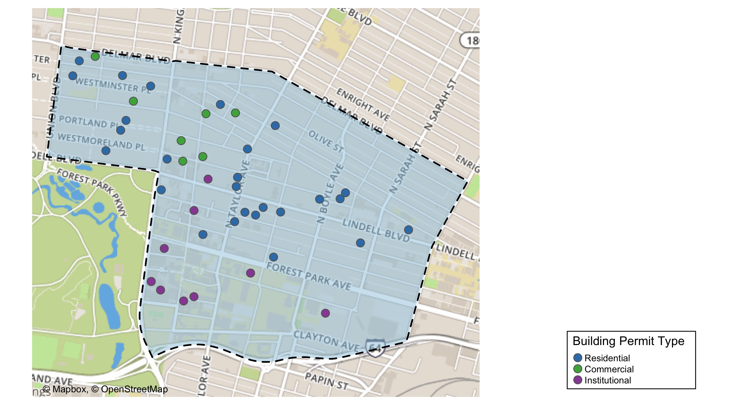
Central West End

Slide 8
Neighborhood Summary
March 2021 | March 2021 | March 2021 | March 2021
Permit Use | Average Cost | # of Permits | Total Value of Permits
Commercial | $70,933 | 7 | $496,529
Industrial | $0 | 0 | $0
Institutional | $165,270 | 14 | $2,313,784
Residential | $346,633 | 27 | $9,359,088
Last 6 Months | Last 6 Months | Last 6 Months | Last 6 Months
Permit Use | Average Cost | # of Permits | Total Value of Permits
Commercial | $1,134,209 | 31 | $35,160,472
Industrial | $0 | 0 | $0
Institutional | $1,425,479 | 59 | $84,103,272
Residential | $448,793 | 109 | $48,918,472

Slide 9
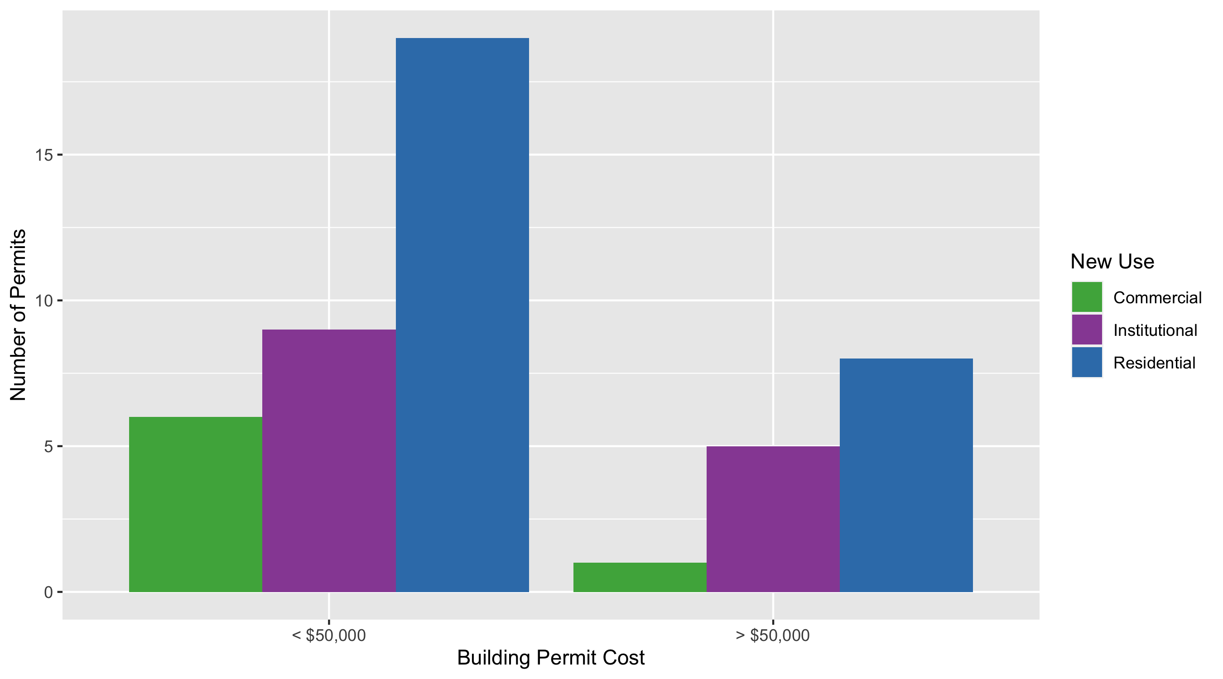
Central West End Permit Cost Breakdown

Slide 10
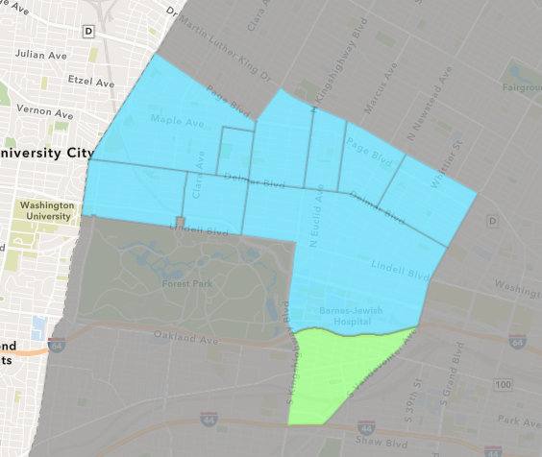
Forest Park Southeast
March 2021 Neighborhood Cost Breakdown
Mean: $87,792
Median: $22,792
Range: $100 - $775,000

Slide 11
Forest Park Southeast: Summary Notes
20 building permits in March 2021
185.71% change compared to March 2020 (7 total building permits)
$87,792: Average building permit cost in March 2021
18.67% change compared to March 2020 ($73,978)
45 total building permits in 2021
114.29% change YTD compared to this time in 2020 (21 total building permits)
$91,992: YTD average building permit cost in 2021
34.33% change YTD compared to this time in 2020 ($68,482)

Slide 12
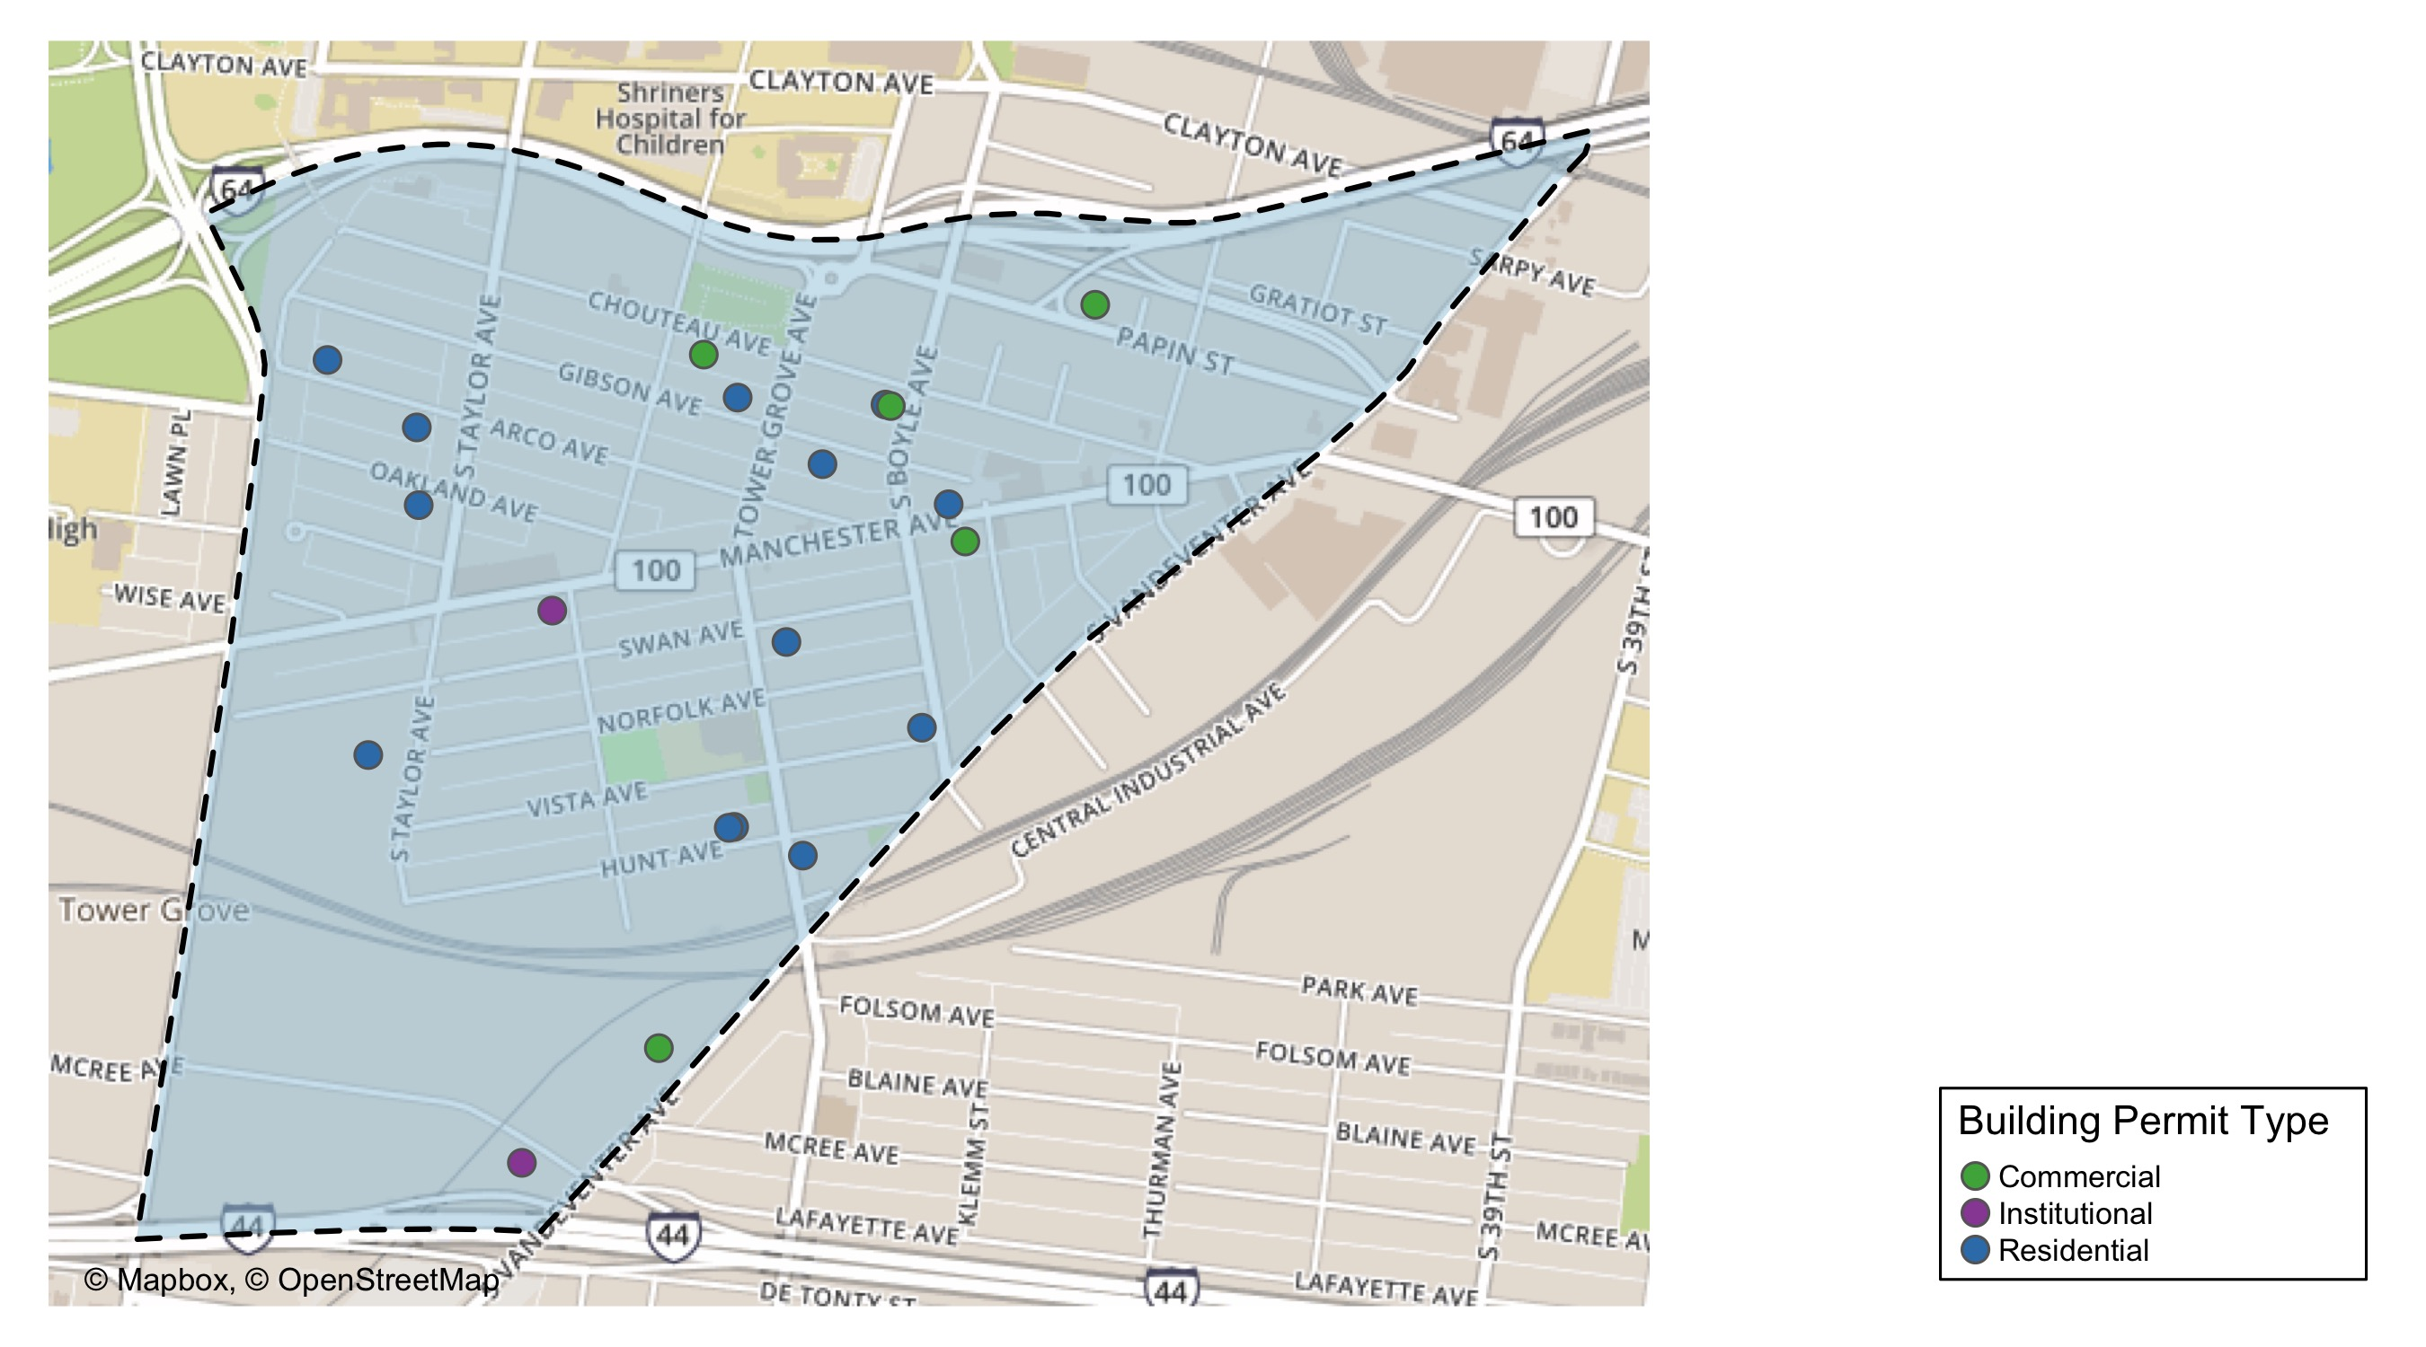
Forest Park Southeast

Slide 13
Neighborhood Summary
March 2021 | March 2021 | March 2021 | March 2021
Permit Use | Average Cost | # of Permits | Total Value of Permits
Commercial | $94,400 | 5 | $472,000
Industrial | $0 | 0 | $0
Institutional | $30,000 | 2 | $60,000
Residential | $94,141 | 13 | $1,223,835
Last 6 Months | Last 6 Months | Last 6 Months | Last 6 Months
Permit Use | Average Cost | # of Permits | Total Value of Permits
Commercial | $54,084 | 14 | $757,171
Industrial | $0 | 0 | $0
Institutional | $476,584 | 12 | $5,719,003
Residential | $1,090,186 | 49 | $53,419,090

Slide 14
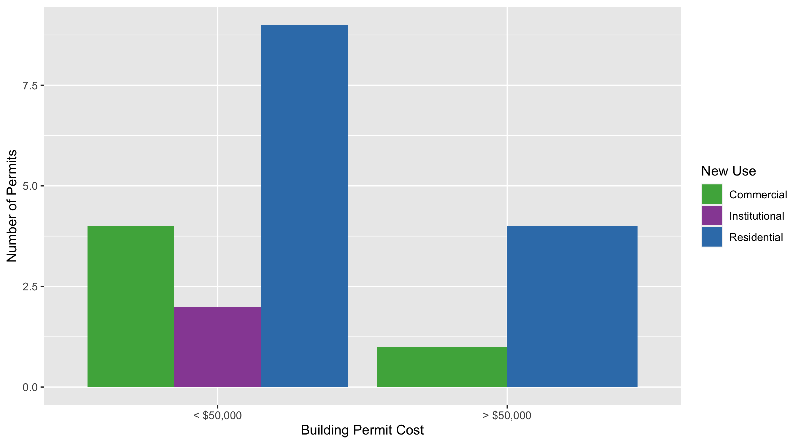
Forest Park Southeast Permit Cost Breakdown

Slide 15
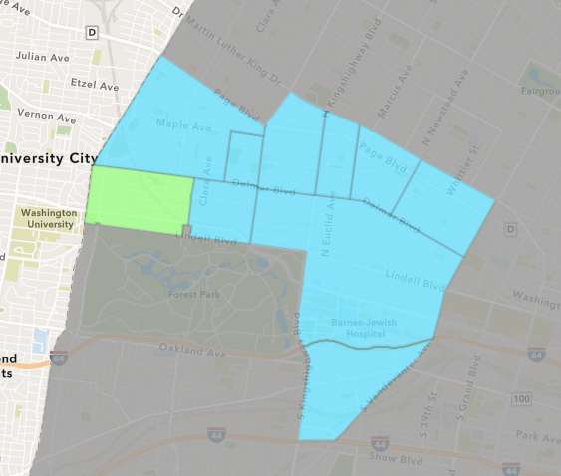
Skinker DeBaliviere
March 2021 Neighborhood Cost Breakdown
Mean: $593,519
Median: $22,000
Range: $2,950 - $5,000,000

Slide 16
Skinker DeBaliviere: Summary Notes
9 building permits in March 2021
-10.00% change compared to March 2020 (10 total building permits)
$593,519: Average building permit cost in March 2021
2622.65% change compared to March 2020 ($21,799)
29 total building permits in 2021
-19.44% change YTD compared to this time in 2020 (36 total building permits)
$208,031: YTD average building permit cost in 2021
939.08% change YTD compared to this time in 2020 ($20,021)

Slide 17
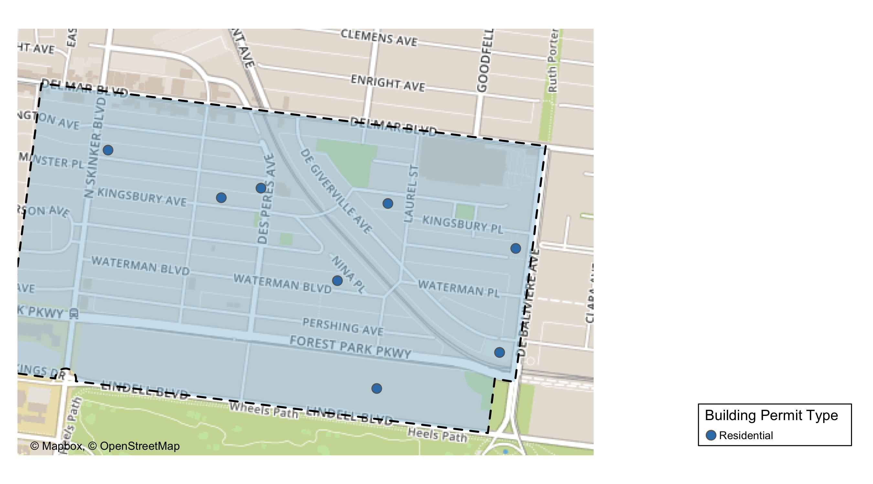
Skinker DeBaliviere

Slide 18
Neighborhood Summary
March 2021 | March 2021 | March 2021 | March 2021
Permit Use | Average Cost | # of Permits | Total Value of Permits
Commercial | $0 | 0 | $0
Industrial | $0 | 0 | $0
Institutional | $0 | 0 | $0
Residential | $593,519 | 9 | $5,341,670
Last 6 Months | Last 6 Months | Last 6 Months | Last 6 Months
Permit Use | Average Cost | # of Permits | Total Value of Permits
Commercial | $10,075 | 4 | $40,300
Industrial | $0 | 0 | $0
Institutional | $414,283 | 3 | $1,242,849
Residential | $138,798 | 48 | $6,662,307

Slide 19
Skinker DeBaliviere Individual Permit Breakdown
Owner | New Use | Cost | address
SUMMERS, GREGINALD E & WANDA M | Residential | $14,669 | 6189 WESTMINSTER PL
EXPO AT FOREST PARK LLC | Residential | $128,210 | 5720 DEGIVERVILLE AV
WINTER GARDEN PRESEVATION LP | Residential | $5,000,000 | 5708 KINGSBURY AV
BRINKLEY, CYNTHIA J | Residential | $12,000 | 5795 LINDELL BLVD
EXPO AT FOREST PARK LLC | Residential | $80,000 | 5720 DEGIVERVILLE AV
BONDS, RONALD | Residential | $75,000 | 5818 WESTMINSTER PL
6005 WESTMINSTER LLC | Residential | $2,950 | 6006 WESTMINSTER PL
NACY, JAMES O II | Residential | $22,000 | 5847 WATERMAN BLVD
BENDER, ELIZABETH A & | Residential | $6,841 | 6045 KINGSBURY AV

Slide 20
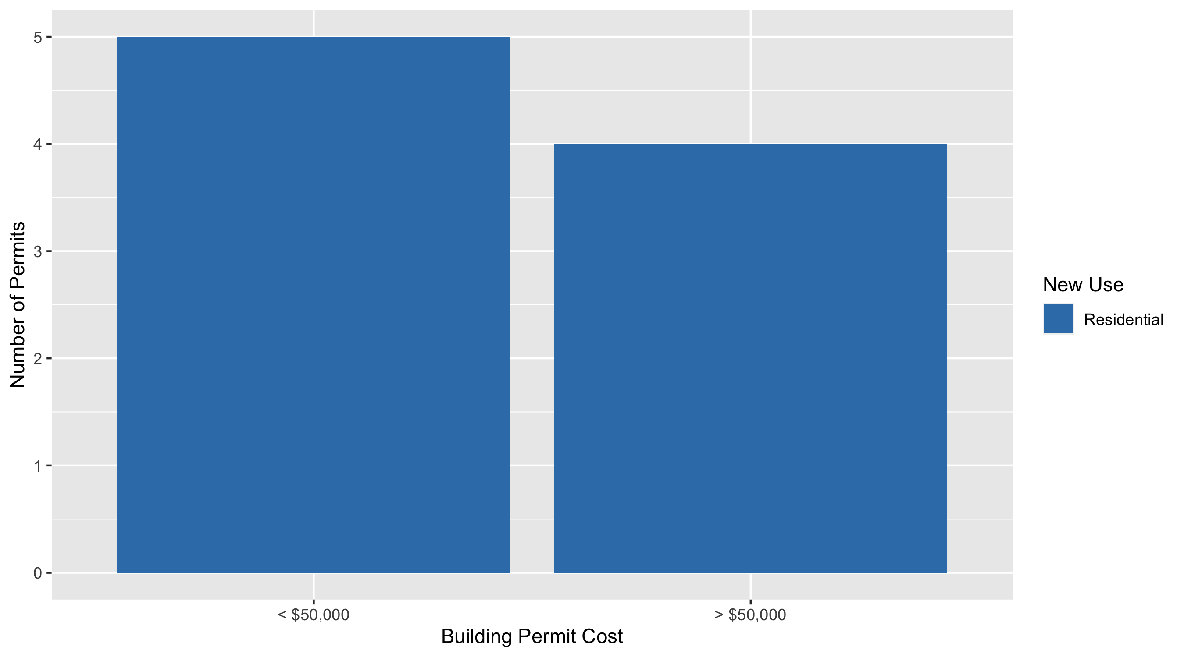
Skinker DeBaliviere Permit Cost Breakdown

Slide 21
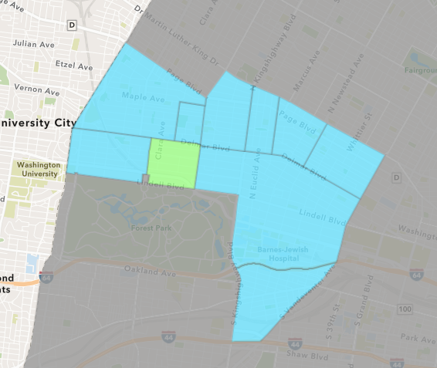
DeBaliviere Place
March 2021 Neighborhood Cost Breakdown
Mean: $170,000
Median: $54,000
Range: $16,000 - $440,000

Slide 22
DeBaliviere Place: Summary Notes
3 building permits in March 2021
-40.00% change compared to March 2020 (5 total building permits)
$170,000: Average building permit cost in March 2021
313.41% change compared to March 2020 ($41,121)
9 total building permits in 2021
0.00% change YTD compared to this time in 2020 (9 total building permits)
$72,450: YTD average building permit cost in 2021
-96.43% change YTD compared to this time in 2020 ($2,028,178)

Slide 23
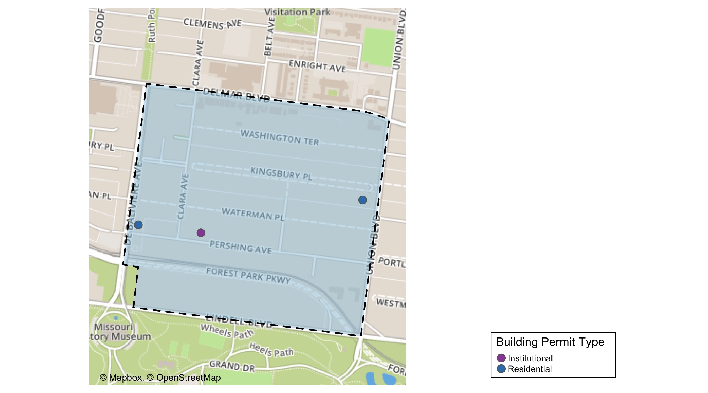
DeBaliviere Place

Slide 24
Neighborhood Summary
March 2021 | March 2021 | March 2021 | March 2021
Permit Use | Average Cost | # of Permits | Total Value of Permits
Commercial | $0 | 0 | $0
Industrial | $0 | 0 | $0
Institutional | $54,000 | 1 | $54,000
Residential | $228,000 | 2 | $456,000
Last 6 Months | Last 6 Months | Last 6 Months | Last 6 Months
Permit Use | Average Cost | # of Permits | Total Value of Permits
Commercial | $15,000 | 1 | $15,000
Industrial | $0 | 0 | $0
Institutional | $54,000 | 1 | $54,000
Residential | $93,457 | 23 | $2,149,506

Slide 25
DeBaliviere Place Individual Permit Breakdown
Owner | New Use | Cost | address
HUDSON KILAMANJARO V LLC | Residential | $440,000 | 5655 PERSHING AV
SEWARD, JERMAL L II & RAHCEL L | Residential | $16,000 | 4 KINGSBURY PL
SERVICE EMPLOYEES INTERNATIONAL UNIO | Institutional | $54,000 | 5585 PERSHING AV

Slide 26
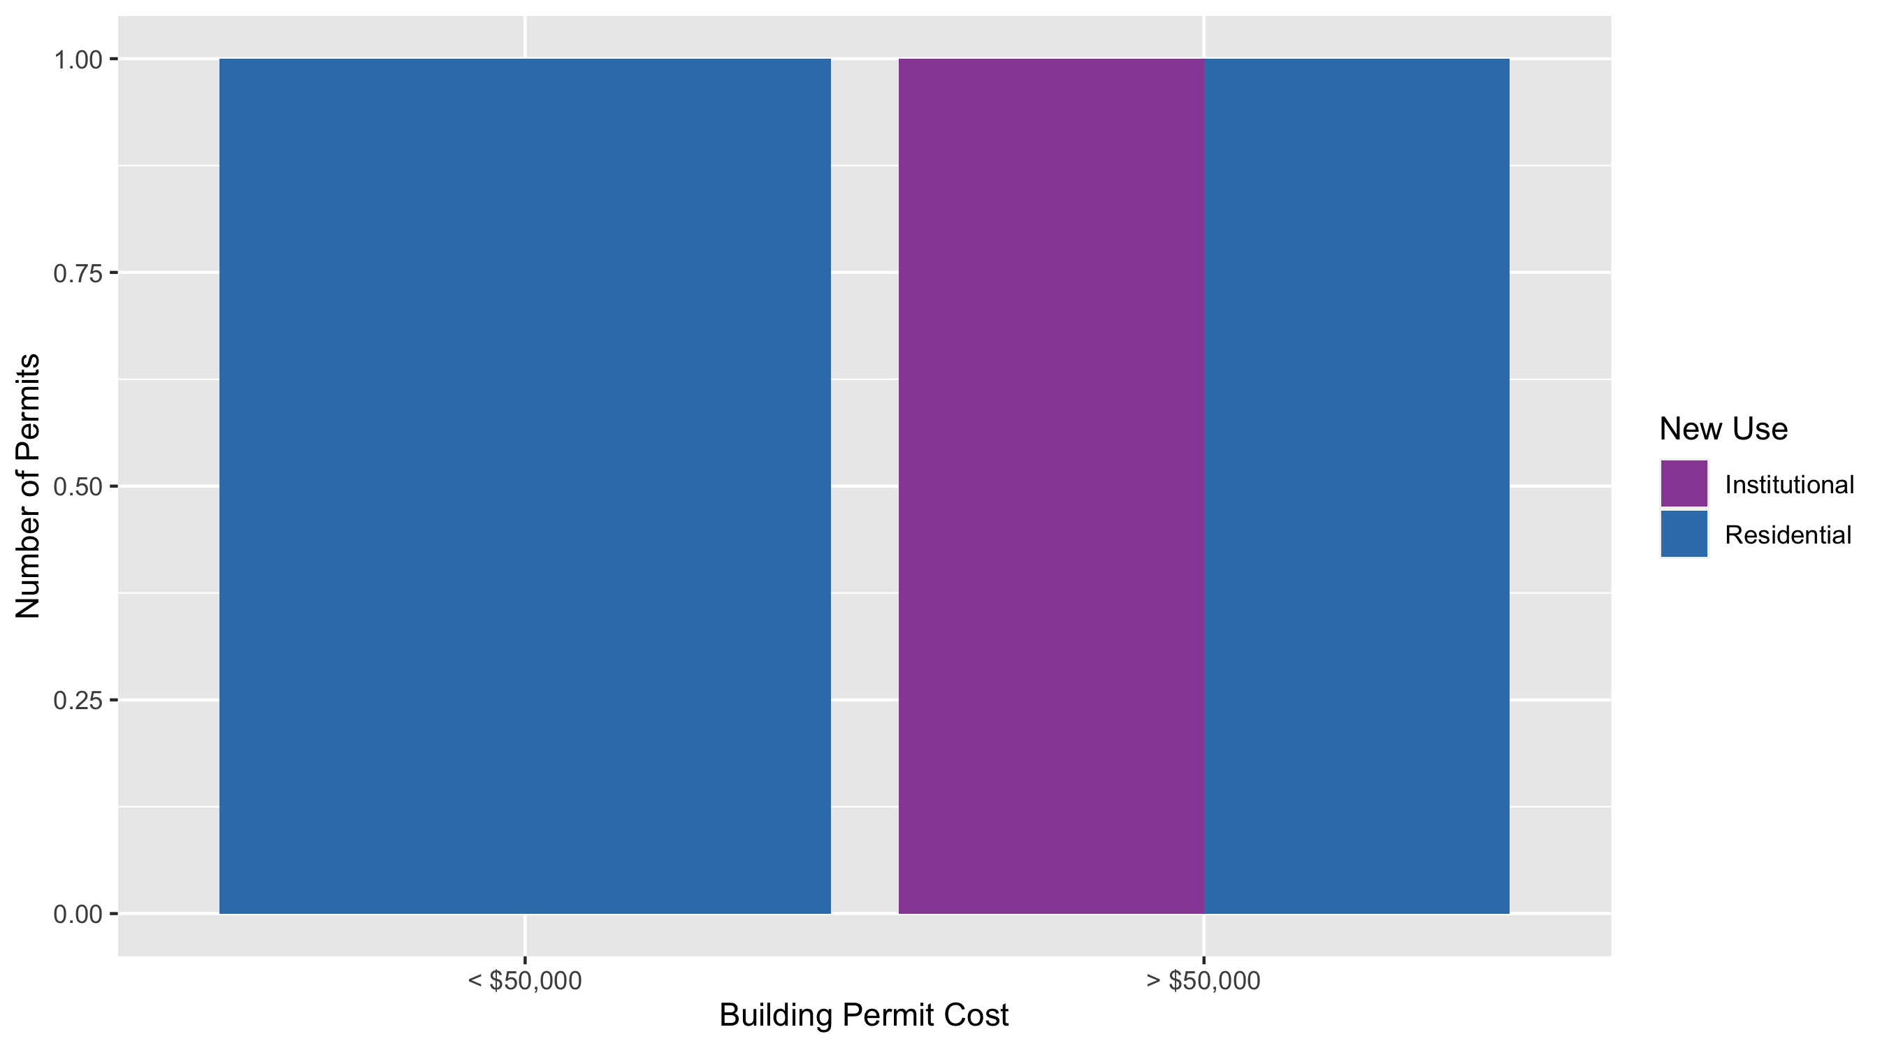
DeBaliviere Place Permit Cost Breakdown

Slide 27
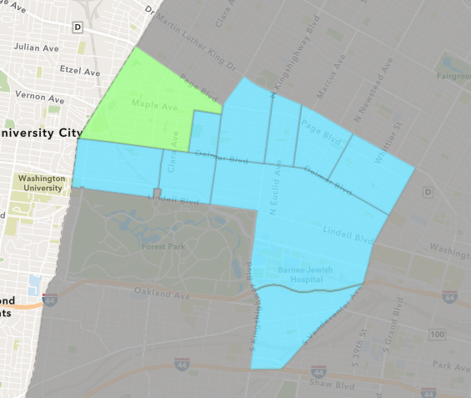
West End
March 2021 Neighborhood Cost Breakdown
Mean: $53,167
Median: $40,000
Range: $4,000 - $120,000

Slide 28
West End: Summary Notes
6 building permits in March 2021
0.00% change compared to March 2020 (6 total building permits)
$53,167: Average building permit cost in March 2021
-37.22% change compared to March 2020 ($84,692)
24 total building permits in 2021
4.35% change YTD compared to this time in 2020 (23 total building permits)
$74,786: YTD average building permit cost in 2021
92.23% change YTD compared to this time in 2020 ($38,904)

Slide 29
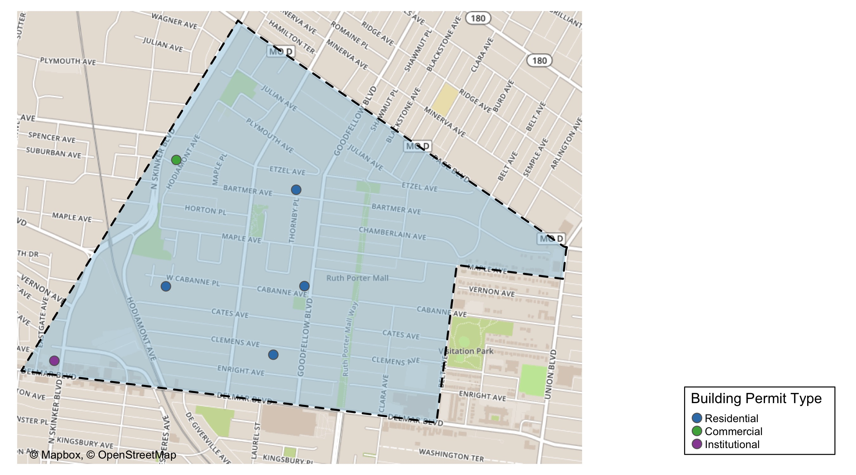
West End

Slide 30
Neighborhood Summary
March 2021 | March 2021 | March 2021 | March 2021
Permit Use | Average Cost | # of Permits | Total Value of Permits
Commercial | $20,000 | 1 | $20,000
Industrial | $0 | 0 | $0
Institutional | $4,000 | 1 | $4,000
Residential | $73,750 | 4 | $295,000
Last 6 Months | Last 6 Months | Last 6 Months | Last 6 Months
Permit Use | Average Cost | # of Permits | Total Value of Permits
Commercial | $37,981 | 9 | $341,830
Industrial | $0 | 0 | $0
Institutional | $12,353 | 2 | $24,706
Residential | $88,855 | 41 | $3,643,036

Slide 31
West End Individual Permit Breakdown
Owner | New Use | Cost | address
BECKEMEYER, BRETT & | Residential | $60,000 | 6040 WEST CABANNE PL
URBAN CORE CONSTRUCTION LLC | Residential | $100,000 | 5835 BARTMER AV
PACE-DELMAR ASSOCIATES LLC | Institutional | $4,000 | 621 N SKINKER BLVD
NGUYEN, DOUG | Residential | $120,000 | 5842 CLEMENS AV
CABANNE GOODFELLOW LLC | Residential | $15,000 | 5803 CABANNE AV
TRICE, TESS | Commercial | $20,000 | 1125 HODIAMONT AV

Slide 32
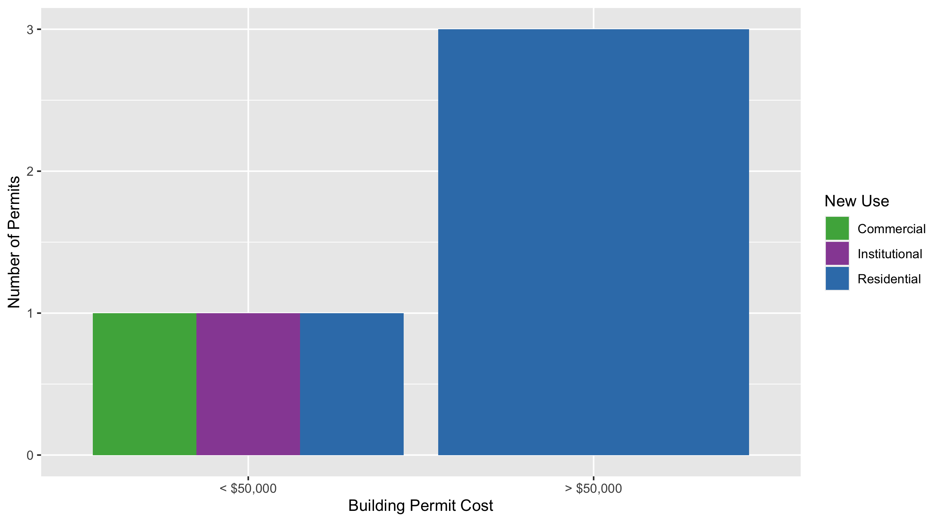
West End Permit Cost Breakdown

Slide 33
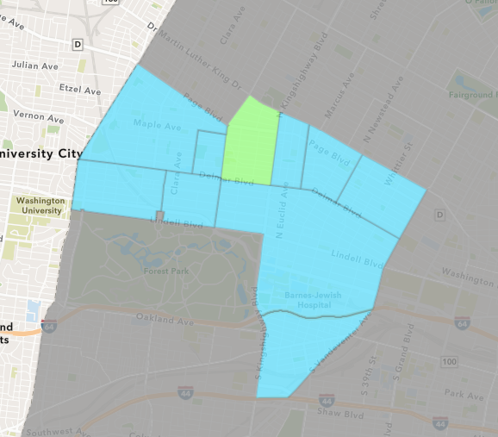
Academy
March 2021 Neighborhood Cost Breakdown
Mean: $50,250
Median: $50,250
Range: $500 - $100,000

Slide 34
Academy: Summary Notes
2 building permits in March 2021
100.00% change compared to March 2020 (1 total building permits)
$50,250: Average building permit cost in March 2021
-40.88% change compared to March 2020 ($85,000)
4 total building permits in 2021
-60.00% change YTD compared to this time in 2020 (10 total building permits)
$29,719: YTD average building permit cost in 2021
-66.03% change YTD compared to this time in 2020 ($87,495)

Slide 35
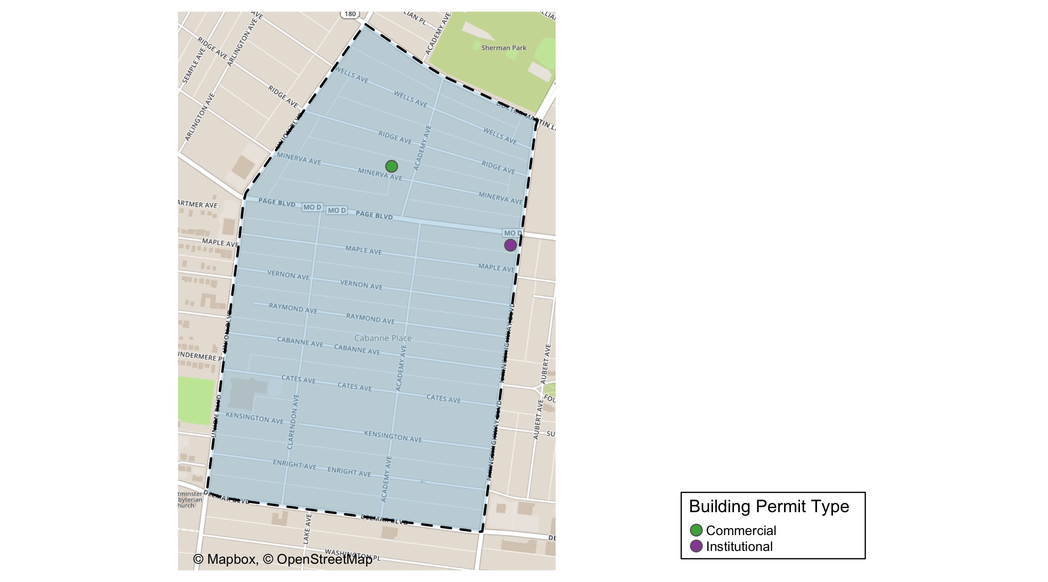
Academy

Slide 36
Neighborhood Summary
March 2021 | March 2021 | March 2021 | March 2021
Permit Use | Average Cost | # of Permits | Total Value of Permits
Commercial | $500 | 1 | $500
Industrial | $0 | 0 | $0
Institutional | $100,000 | 1 | $100,000
Residential | $0 | 0 | $0
Last 6 Months | Last 6 Months | Last 6 Months | Last 6 Months
Permit Use | Average Cost | # of Permits | Total Value of Permits
Commercial | $7,750 | 2 | $15,500
Industrial | $0 | 0 | $0
Institutional | $52,750 | 2 | $105,500
Residential | $22,820 | 14 | $319,474

Slide 37
Academy Individual Permit Breakdown
Owner | New Use | Cost | address
SAINT LOUIS LOAN CO LLC | Institutional | $100,000 | 1259 N KINGSHIGHWAY BLVD
BENFORD, RAHMINA & ERIC BENFORD SR | Commercial | $500 | 5123-25 MINERVA AV

Slide 38
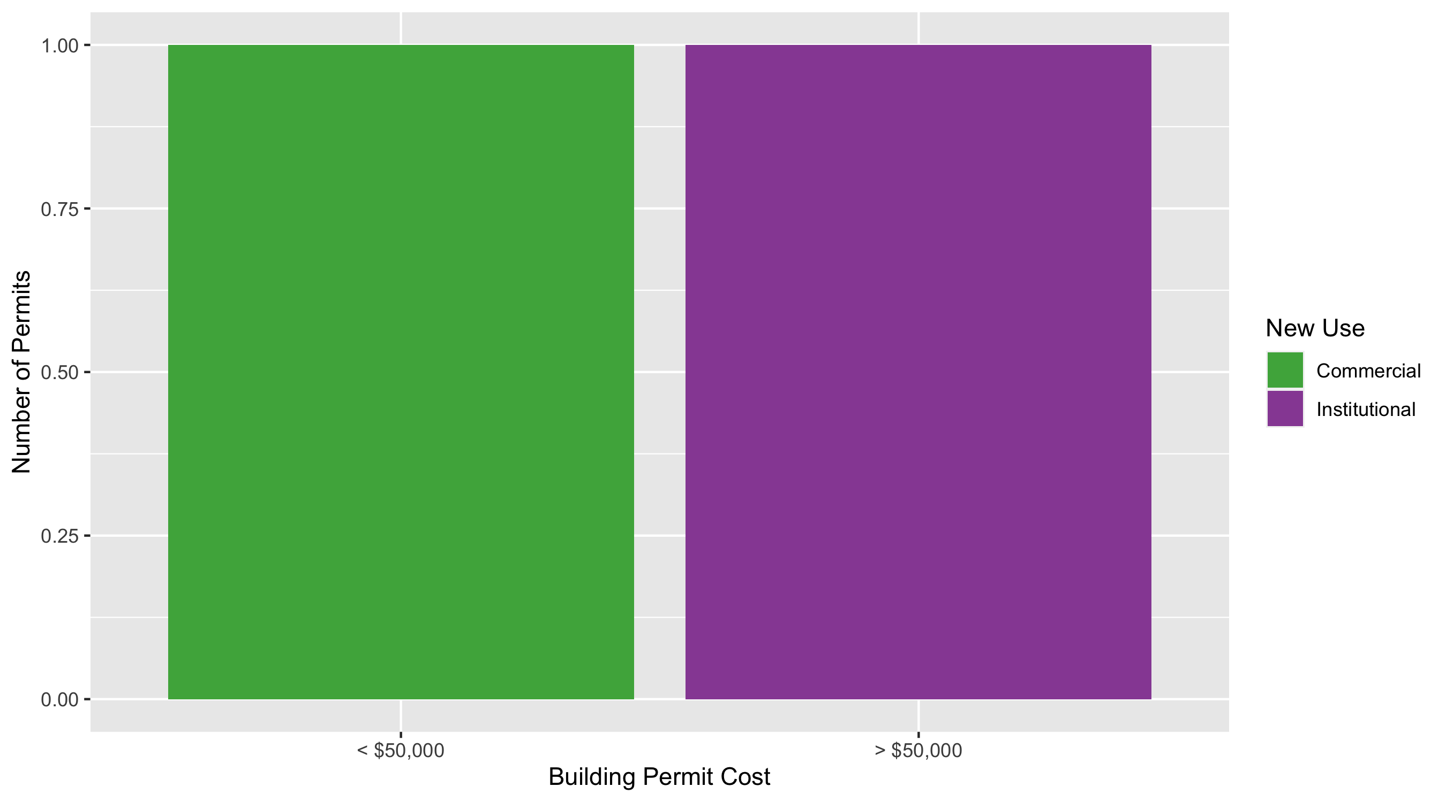
Academy Permit Cost Breakdown

Slide 39
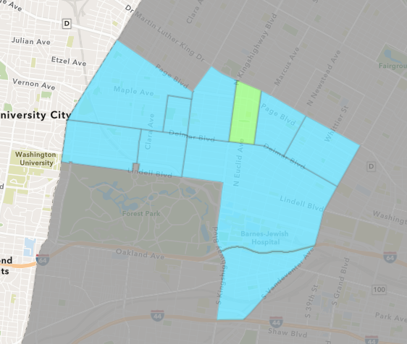
Fountain Park
March 2021 Neighborhood Cost Breakdown
Mean: $407,321
Median: $1,000
Range: $500 - $2,816,747

Slide 40
Fountain Park: Summary Notes
7 building permits in March 2021
600.00% change compared to March 2020 (1 total building permits)
$407,321: Average building permit cost in March 2021
20266.05% change compared to March 2020 ($2,000)
10 total building permits in 2021
900.00% change YTD compared to this time in 2020 (1 total building permits)
$639,860: YTD average building permit cost in 2021
31892.98% change YTD compared to this time in 2020 ($2,000)

Slide 41
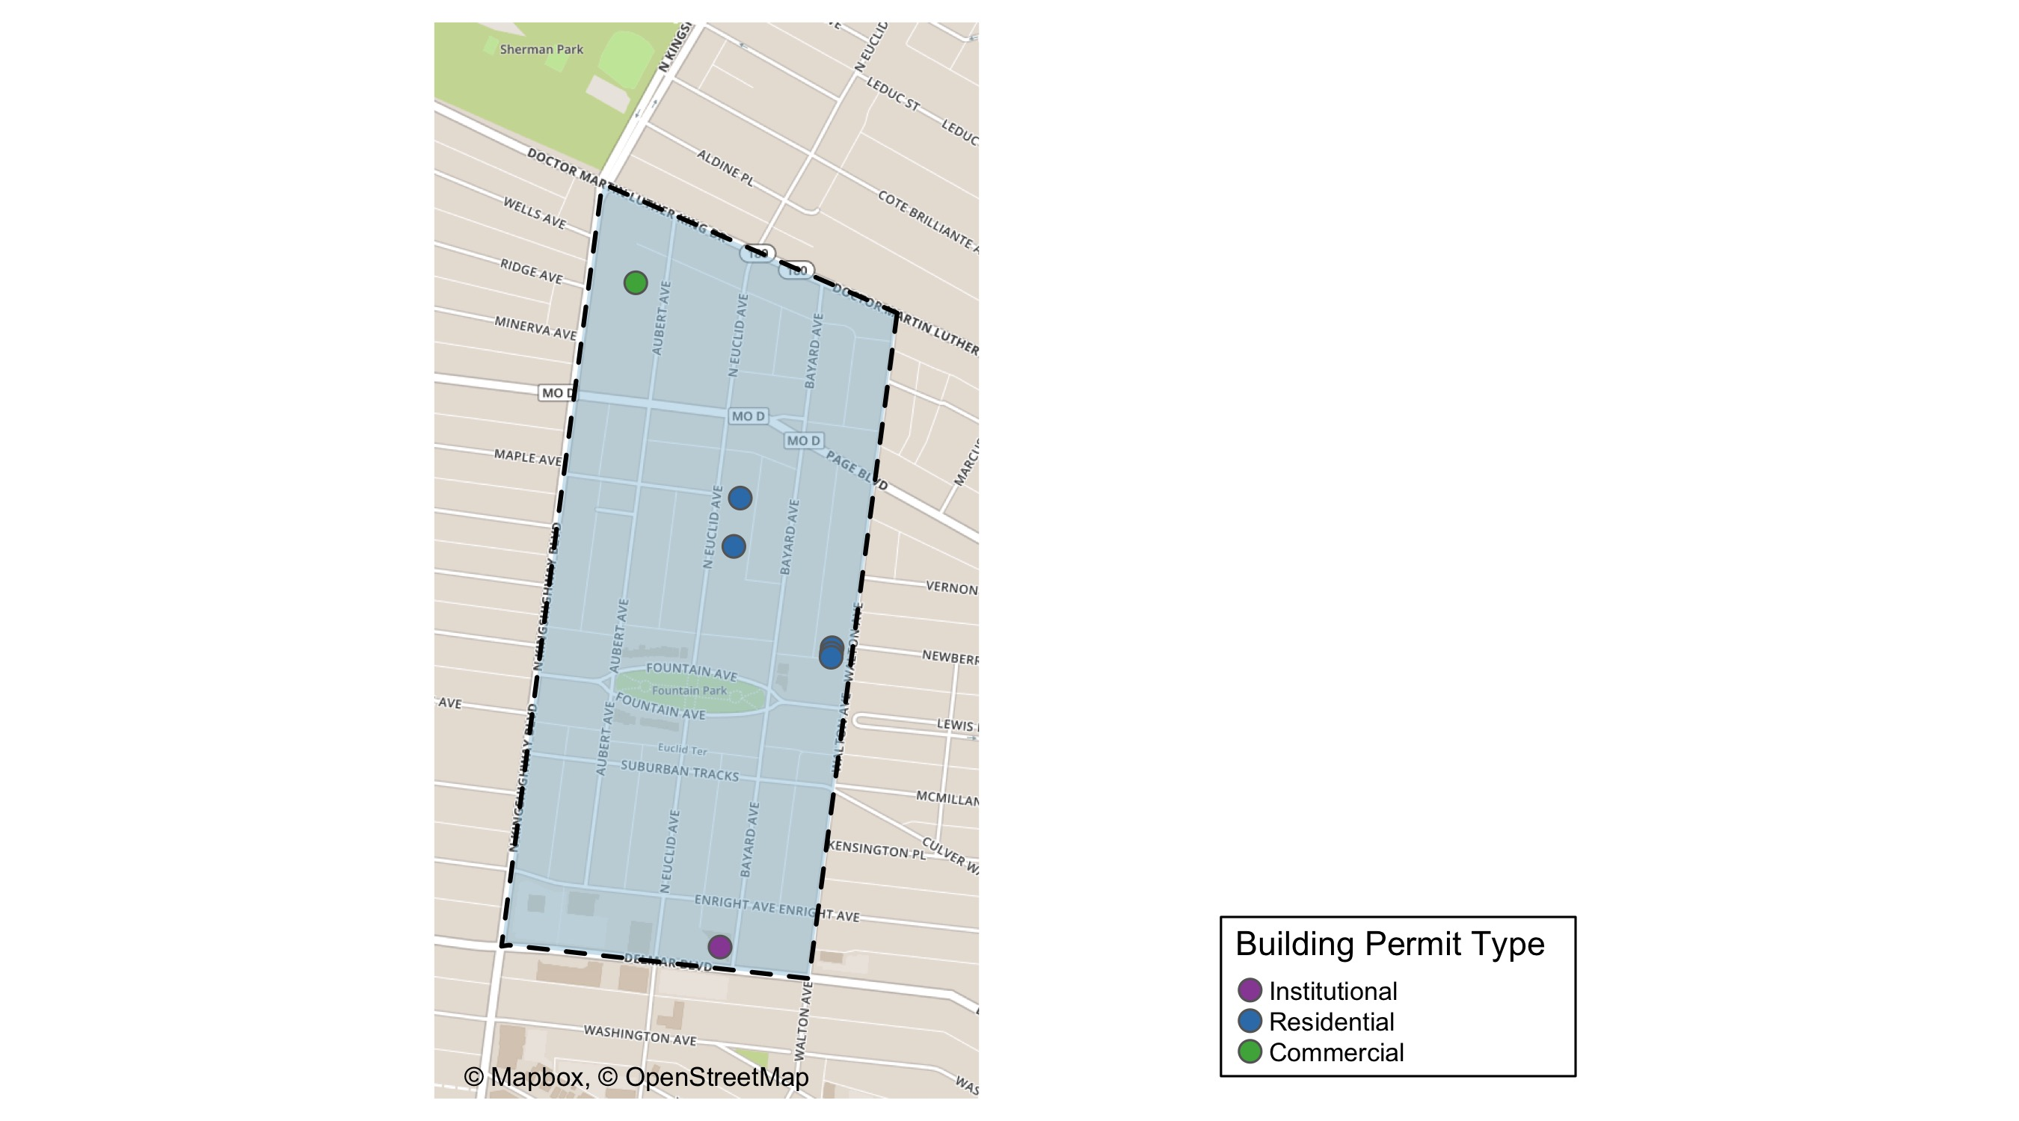
Fountain Park

Slide 42
Neighborhood Summary
March 2021 | March 2021 | March 2021 | March 2021
Permit Use | Average Cost | # of Permits | Total Value of Permits
Commercial | $25,000 | 1 | $25,000
Industrial | $0 | 0 | $0
Institutional | $2,816,747 | 1 | $2,816,747
Residential | $1,900 | 5 | $9,500
Last 6 Months | Last 6 Months | Last 6 Months | Last 6 Months
Permit Use | Average Cost | # of Permits | Total Value of Permits
Commercial | $255,000 | 3 | $765,000
Industrial | $0 | 0 | $0
Institutional | $1,884,698 | 3 | $5,654,095
Residential | $1,900 | 5 | $9,500

Slide 43
Fountain Park Individual Permit Breakdown
Owner | New Use | Cost | address
LEWIS, DEIDRE | Residential | $500 | 1232-34 N EUCLID AV
URBAN LEAGUE OF METROPOLITAM ST LOUI | Commercial | $25,000 | 1408 N KINGSHIGHWAY BLVD
LRA | Residential | $1,000 | 1129 WALTON AV
RATERMAN, KATHERINE R | Residential | $6,000 | 1208 N EUCLID AV
LAUNCHCODE 4811 DELMAR BUILDING OWNE | Institutional | $2,816,747 | 4811 DELMAR BLVD
LRA | Residential | $1,000 | 1125 WALTON AV
LRA | Residential | $1,000 | 1127 WALTON AV

Slide 44
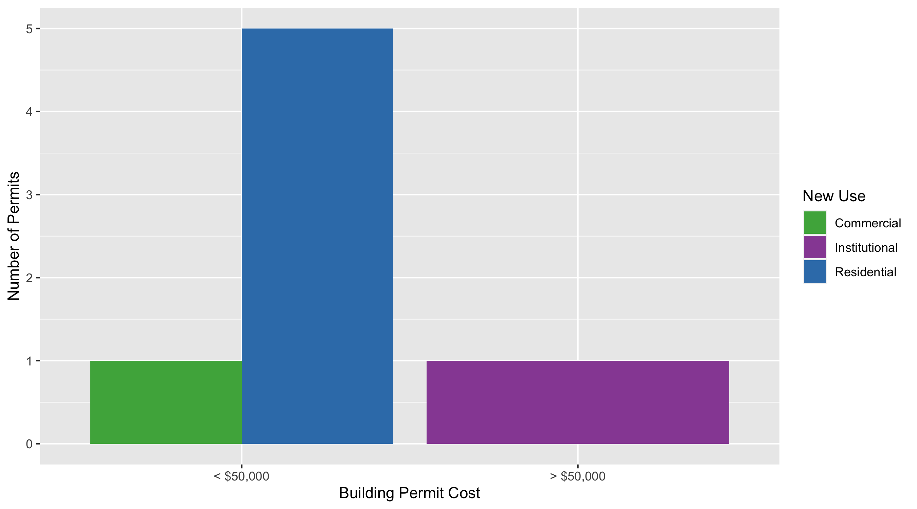
Fountain Park Permit Cost Breakdown

Slide 45
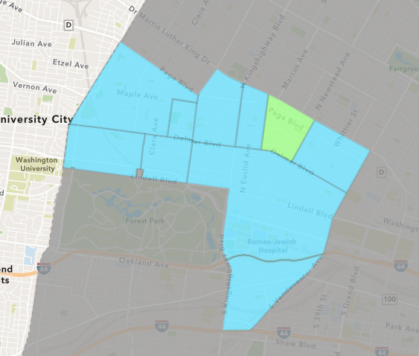
Lewis Place
March 2021 Neighborhood Cost Breakdown
Mean: $1,000
Median: $1,000
Range: $1,000 - $1,000

Slide 46
Lewis Place: Summary Notes
1 building permits in March 2021
Infinite change compared to March 2020 (0 total building permits)
$1,000: Average building permit cost in March 2021
Infinite change compared to March 2020 ($0)
5 total building permits in 2021
400.00% change YTD compared to this time in 2020 (1 total building permits)
$14,120: YTD average building permit cost in 2021
464.80% change YTD compared to this time in 2020 ($2,500)

Slide 47
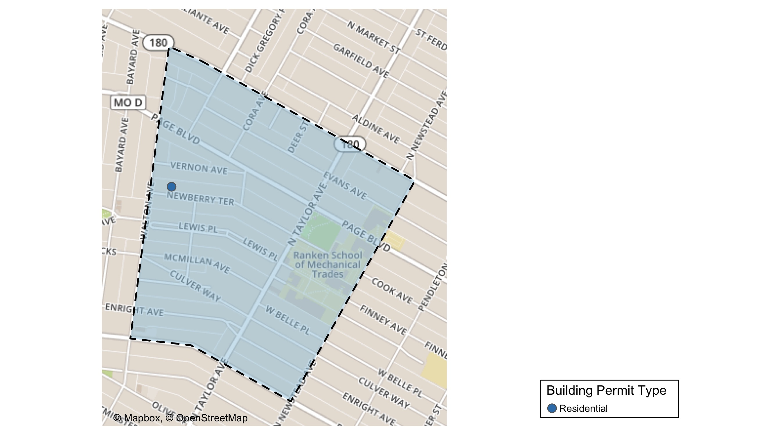
Lewis Place

Slide 48
Neighborhood Summary
March 2021 | March 2021 | March 2021 | March 2021
Permit Use | Average Cost | # of Permits | Total Value of Permits
Commercial | $0 | 0 | $0
Industrial | $0 | 0 | $0
Institutional | $0 | 0 | $0
Residential | $1,000 | 1 | $1,000
Last 6 Months | Last 6 Months | Last 6 Months | Last 6 Months
Permit Use | Average Cost | # of Permits | Total Value of Permits
Commercial | $6,000 | 1 | $6,000
Industrial | $0 | 0 | $0
Institutional | $10,000 | 1 | $10,000
Residential | $10,118 | 9 | $91,063

Slide 49
Lewis Place Individual Permit Breakdown
Owner | New Use | Cost | address
LRA | Residential | $1,000 | 4731-33 NEWBERRY TER

Slide 50
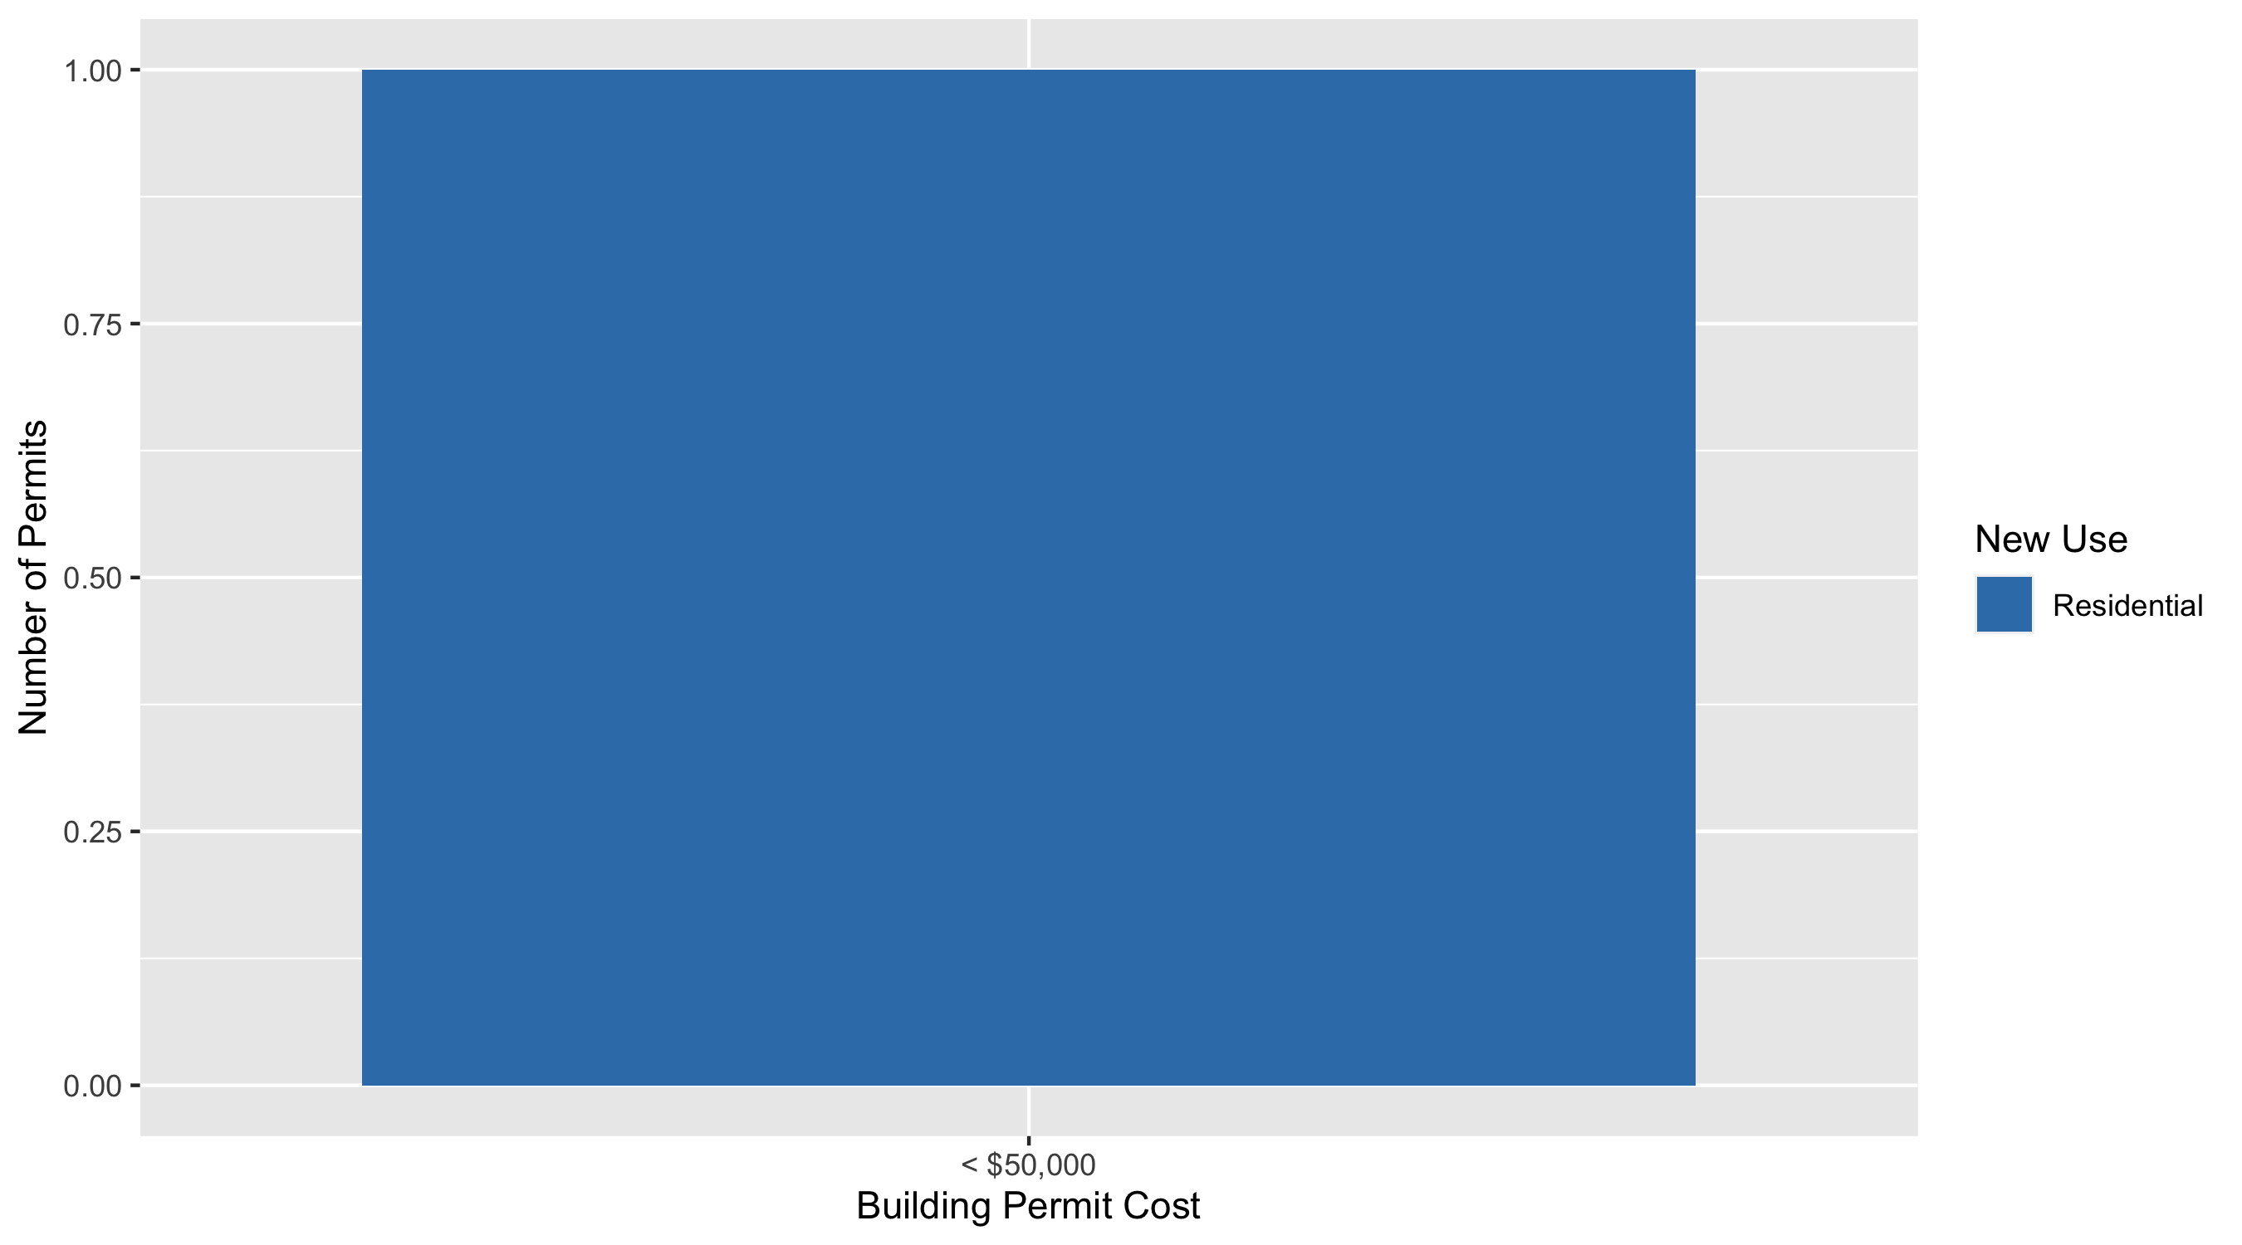
Lewis Place Permit Cost Breakdown

Slide 51
Additional Notes
Data retreived from https://www.stlouis-mo.gov/data/
Building permits with a cost of $0 were dropped
Building permits that were cancelled were dropped
Infinite change indicates 0 permits in the current or previous time period/comparison month so there was a overall increase or decrease

